Slide 1

Android Project
Team member: You Fu, Zhengyang Xu, Xinyue Cai, Di Weng, Ziyu Zhou

Slide 2

Introduction of Project

Slide 3
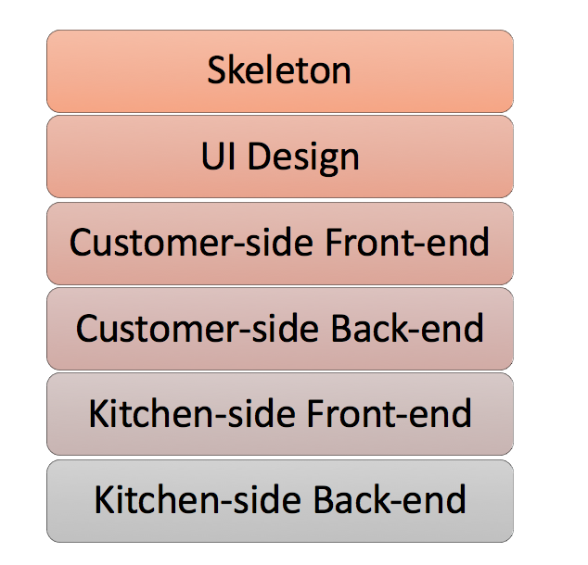
Work Distribution
Whole Team
Zhengyang Xu
Xinyue Cai
You Fu
Ziyu Zhou
Di Weng

Slide 4
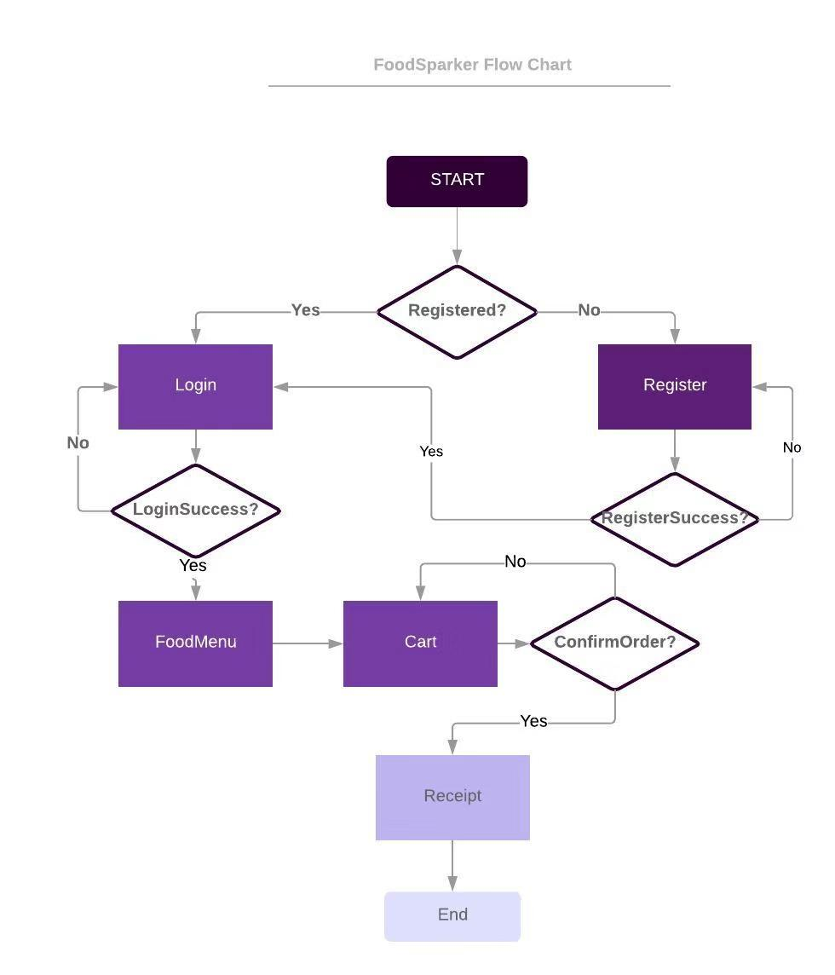
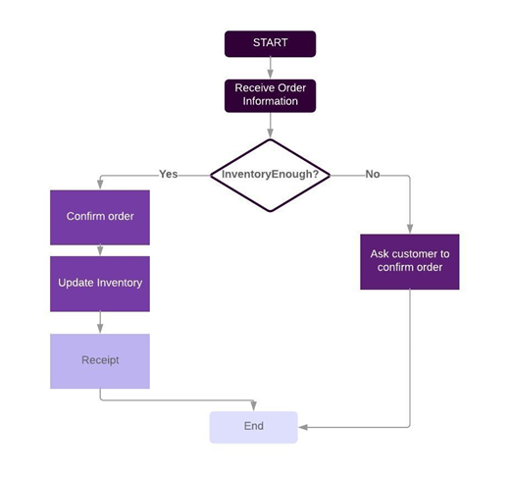
Flow Chart

Slide 5
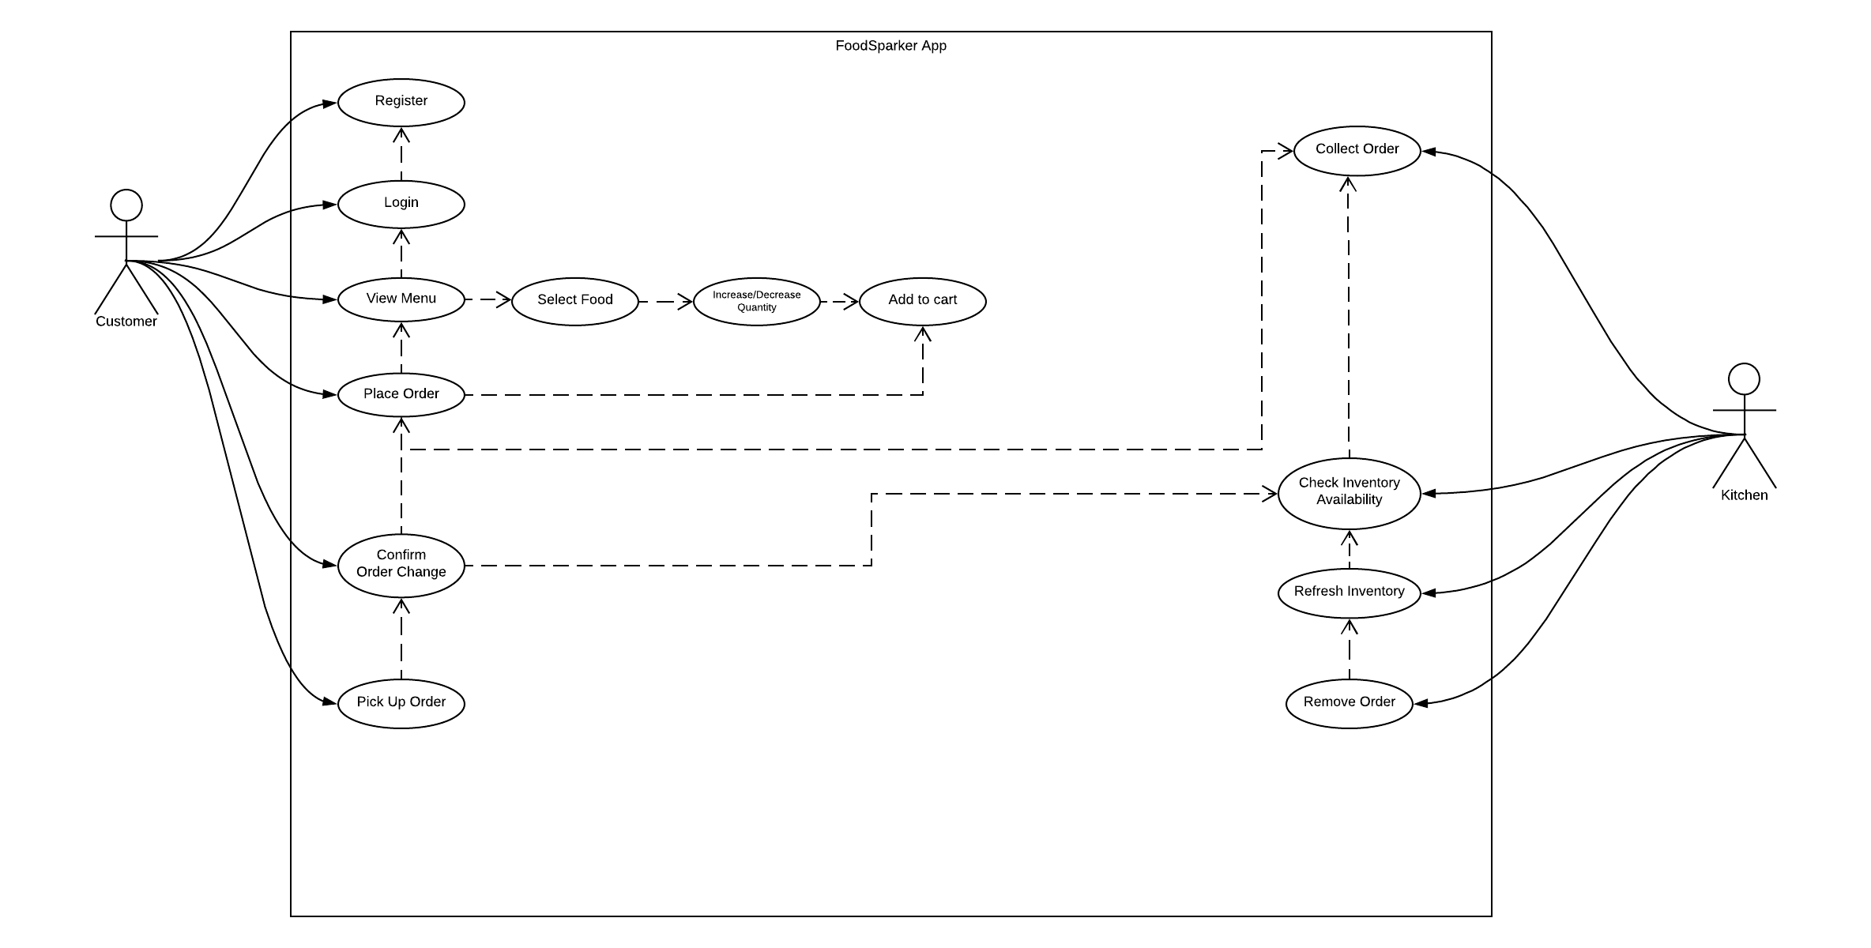
Use-case Diagram

Slide 6
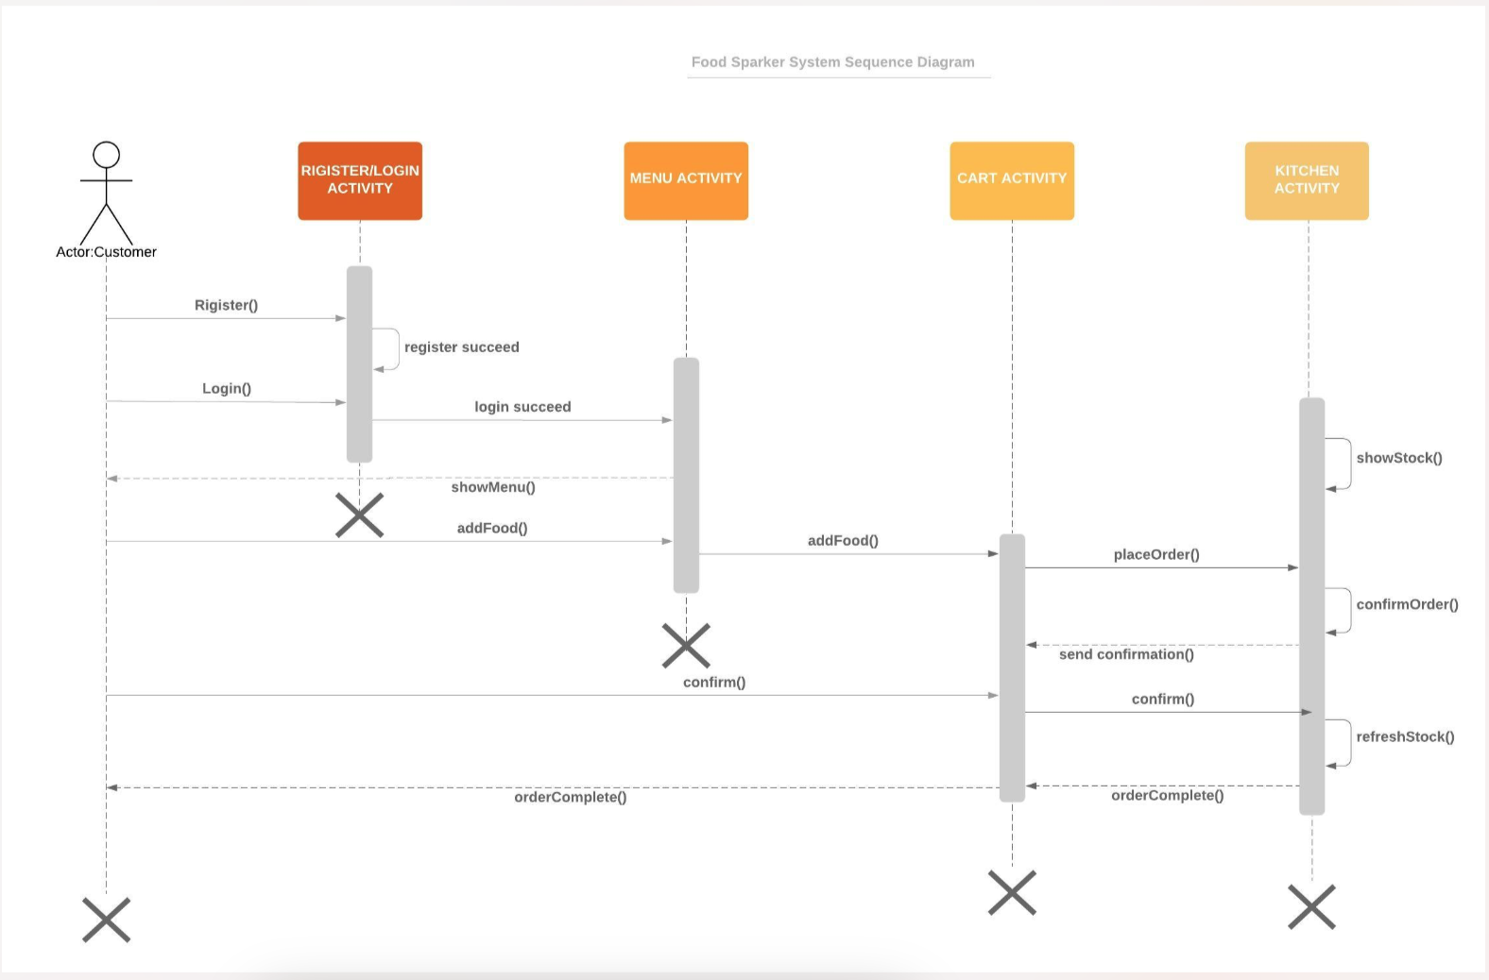
Sequence Diagram

Slide 7
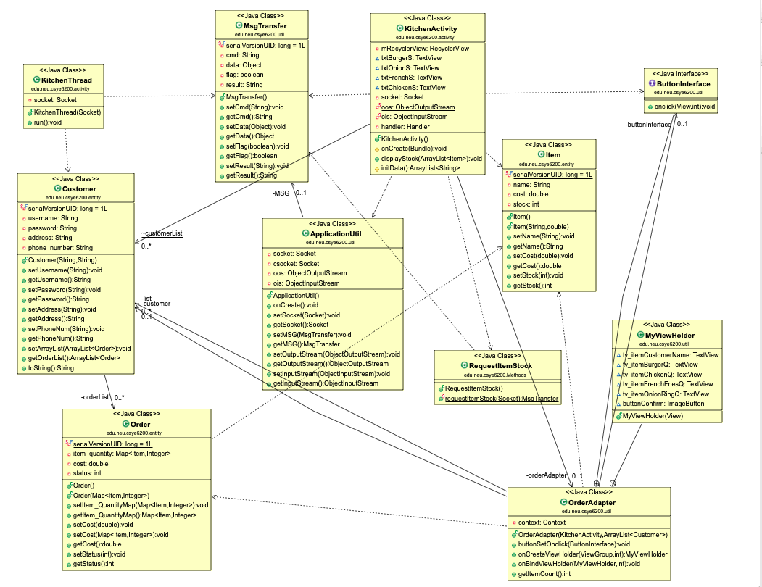
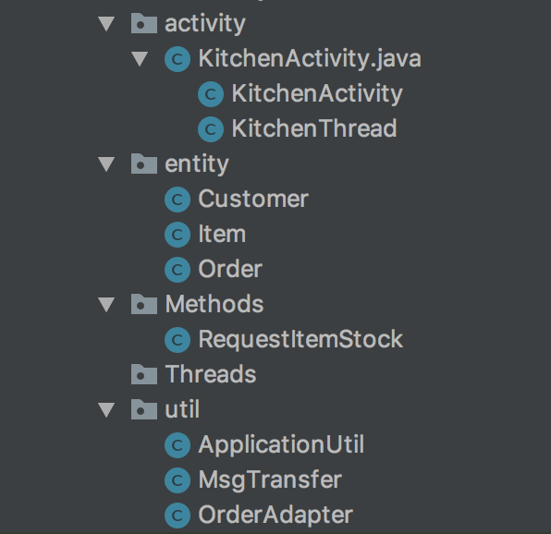
Class Diagram

Slide 8
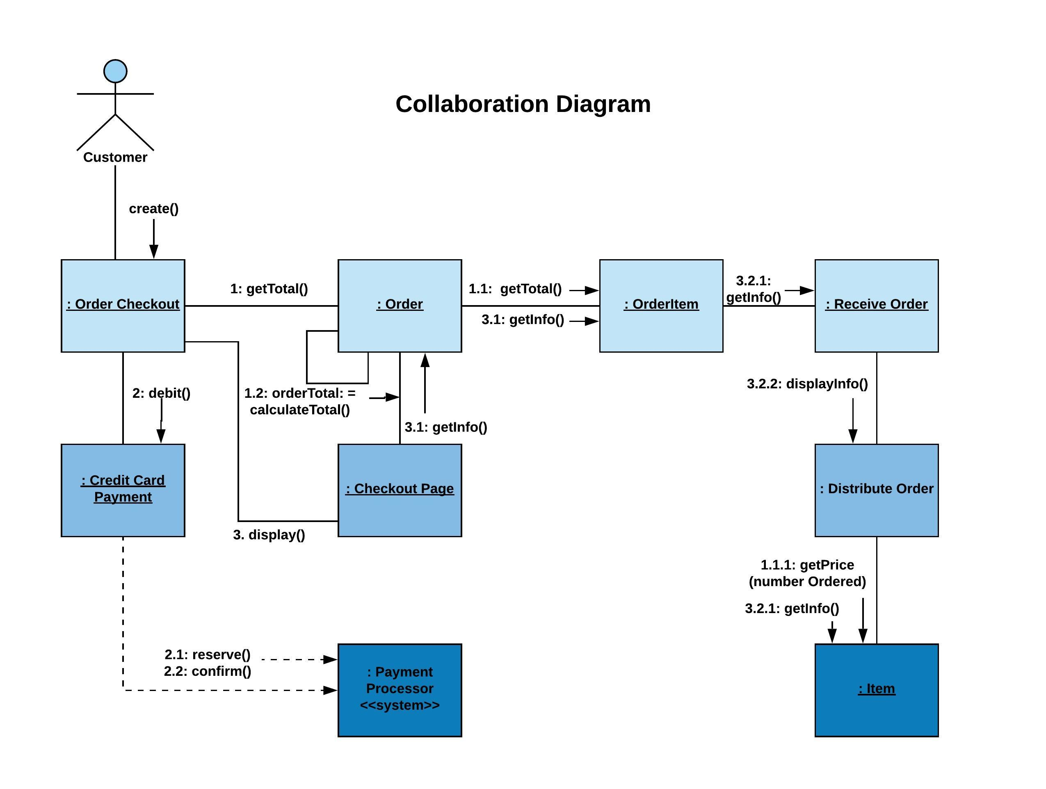
Collaboration Diagram

Slide 9
Project Skeleton Design

Slide 10
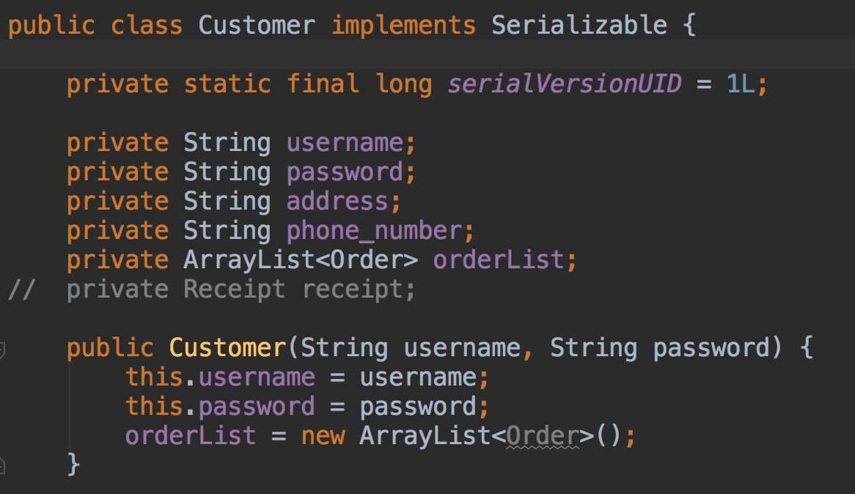
Customer

Slide 11
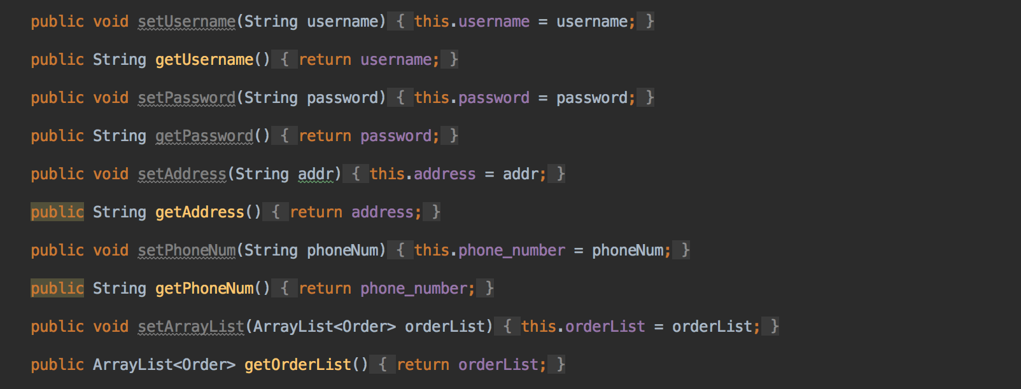
Customer

Slide 12
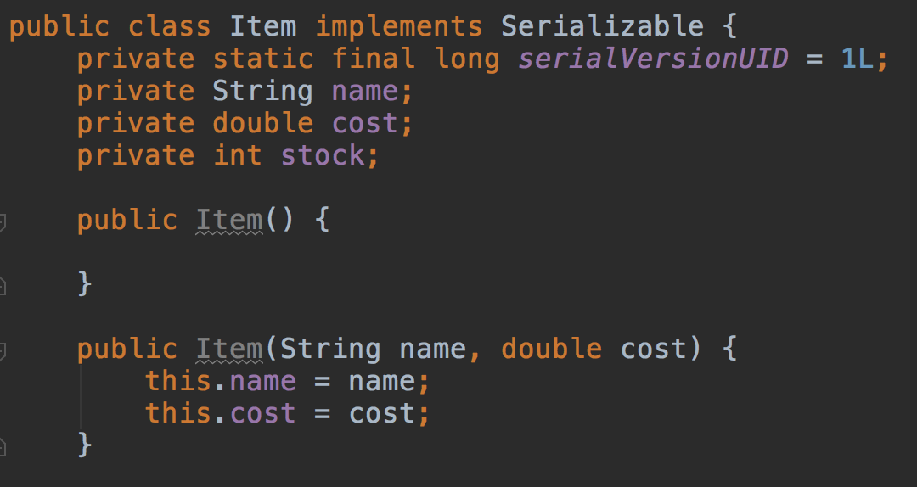
Item

Slide 13
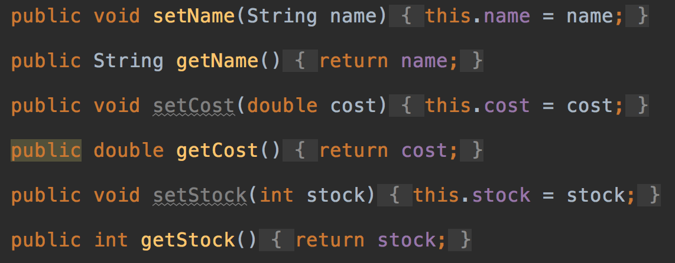
Item

Slide 14
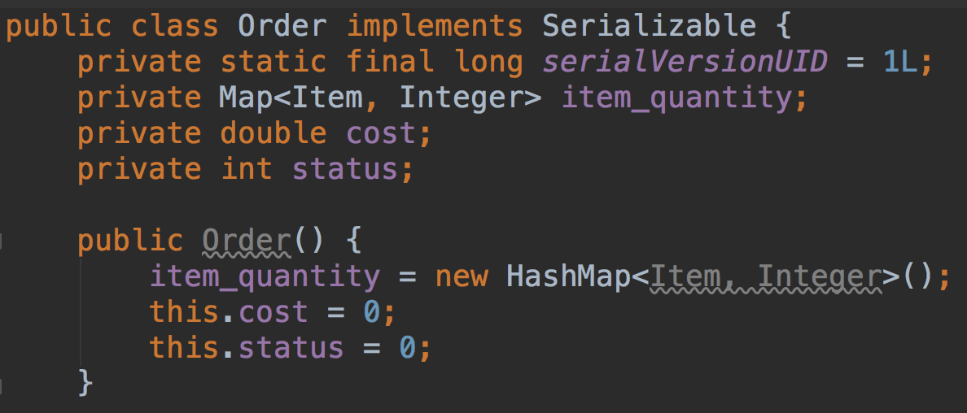
Order

Slide 15
Customer: Front-end

Slide 16
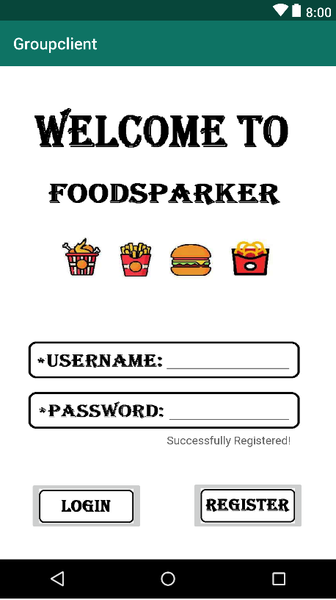
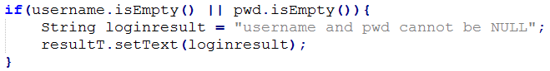
Login Activity
UI Component
ImageButton: Login/Register
TextView: Allow customer to type in username and password
Data Validation
IsEmpty()
If not registered, press REGISTER after typing in username and password Successfully Registered
If already registered, press REGISTER Register failed
If not registered, press LOGIN Login failed
If registered, press LOGIN turn to next screen

Slide 17
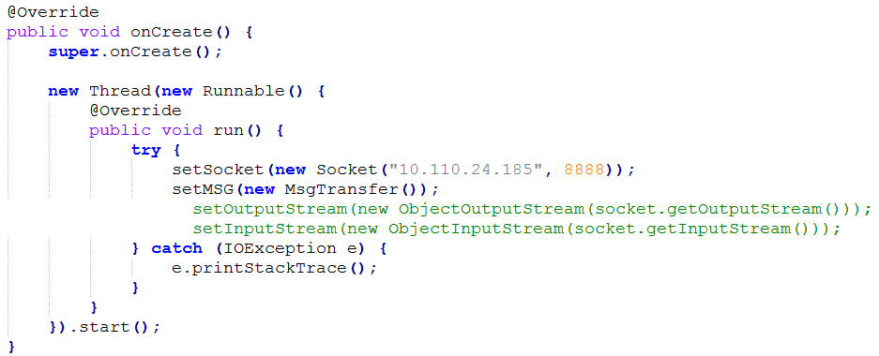
Login Activity
ApplicationUtil

Slide 18
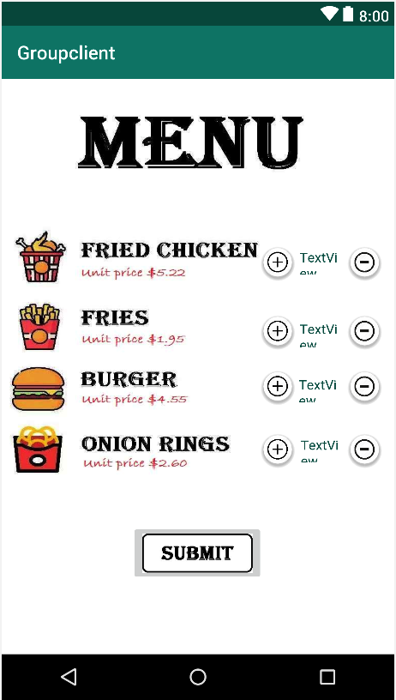
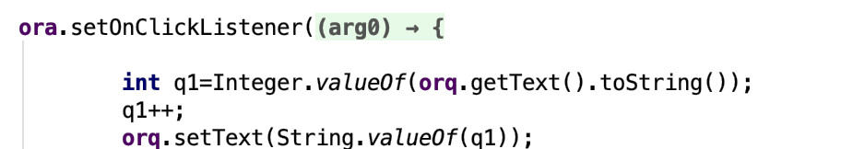
Menu Activity
UI Component
FloatingActionButton - +/-: Increase/Decrease Quantity
TextView: Show quantity – chickq, ffq, burgerq, orq

Slide 19
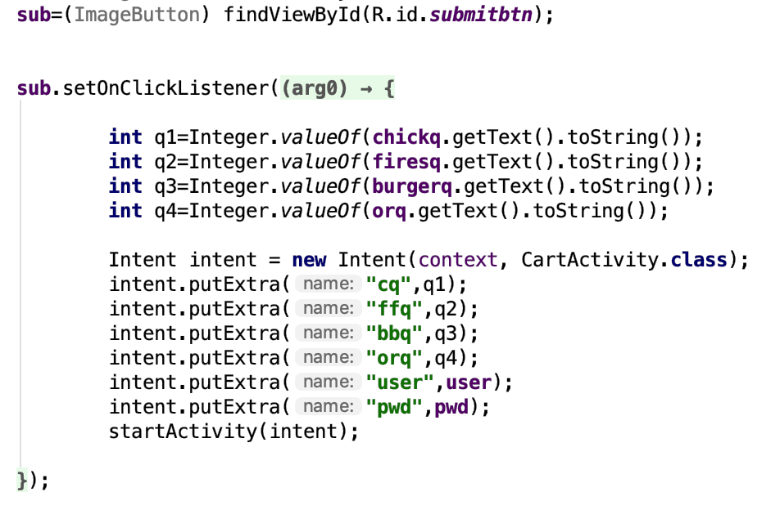
Menu Activity
ImageButton – Submit: pass quantity value to cart activity

Slide 20
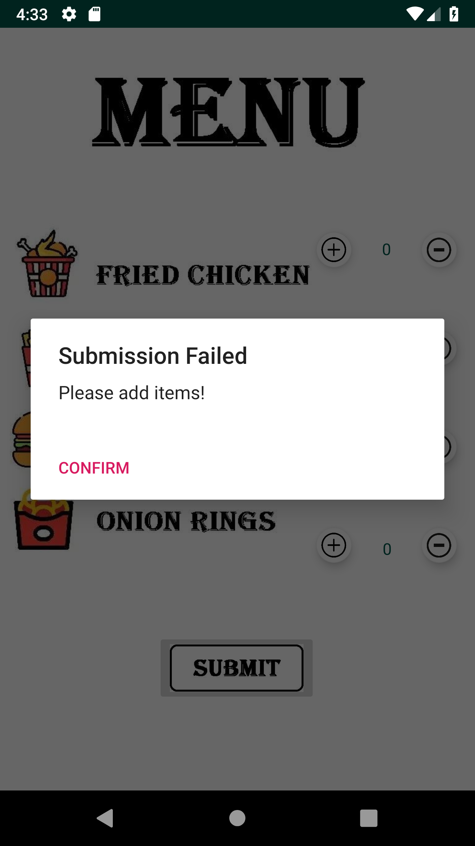
Menu Activity
Pop-Up Screen
Item quantities cannot be zero
Submission Failed

Slide 21
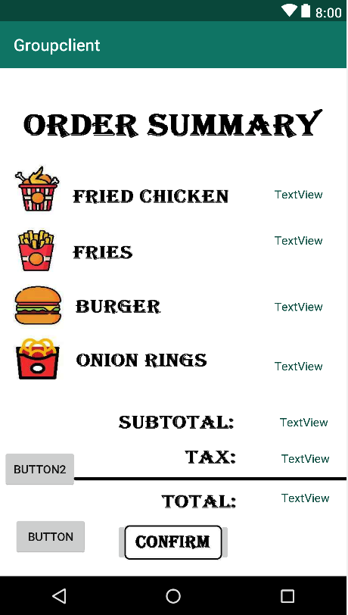
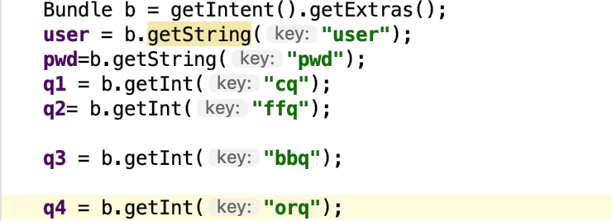
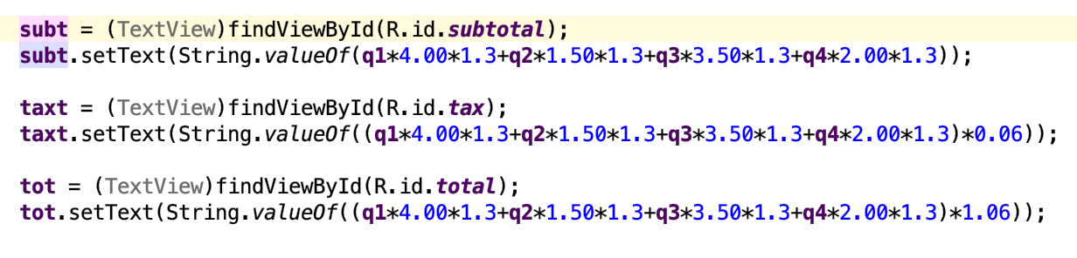
Cart Activity
UI Component:
TextView – Item quantities
Get data from Bundle
TextView – Calculate Subtotal, Tax and Total

Slide 22
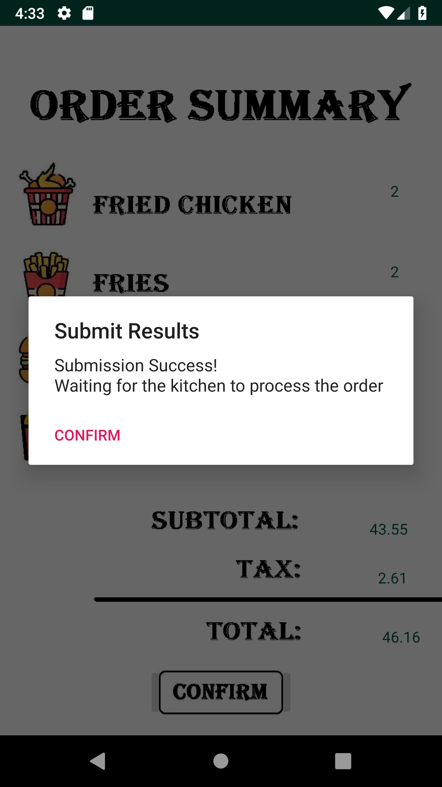
Cart Activity
ImageButton: Confirm
Order → Order List → Customer → MSG
Pass to Server as an MSG
Order stored as Map
Key: item
Value: quantity
Pop-Up Screen
Notify customer the order has been sent to the kitchen
When kitchen is confirmed with the order, a notification sent to the customer telling the results

Slide 23
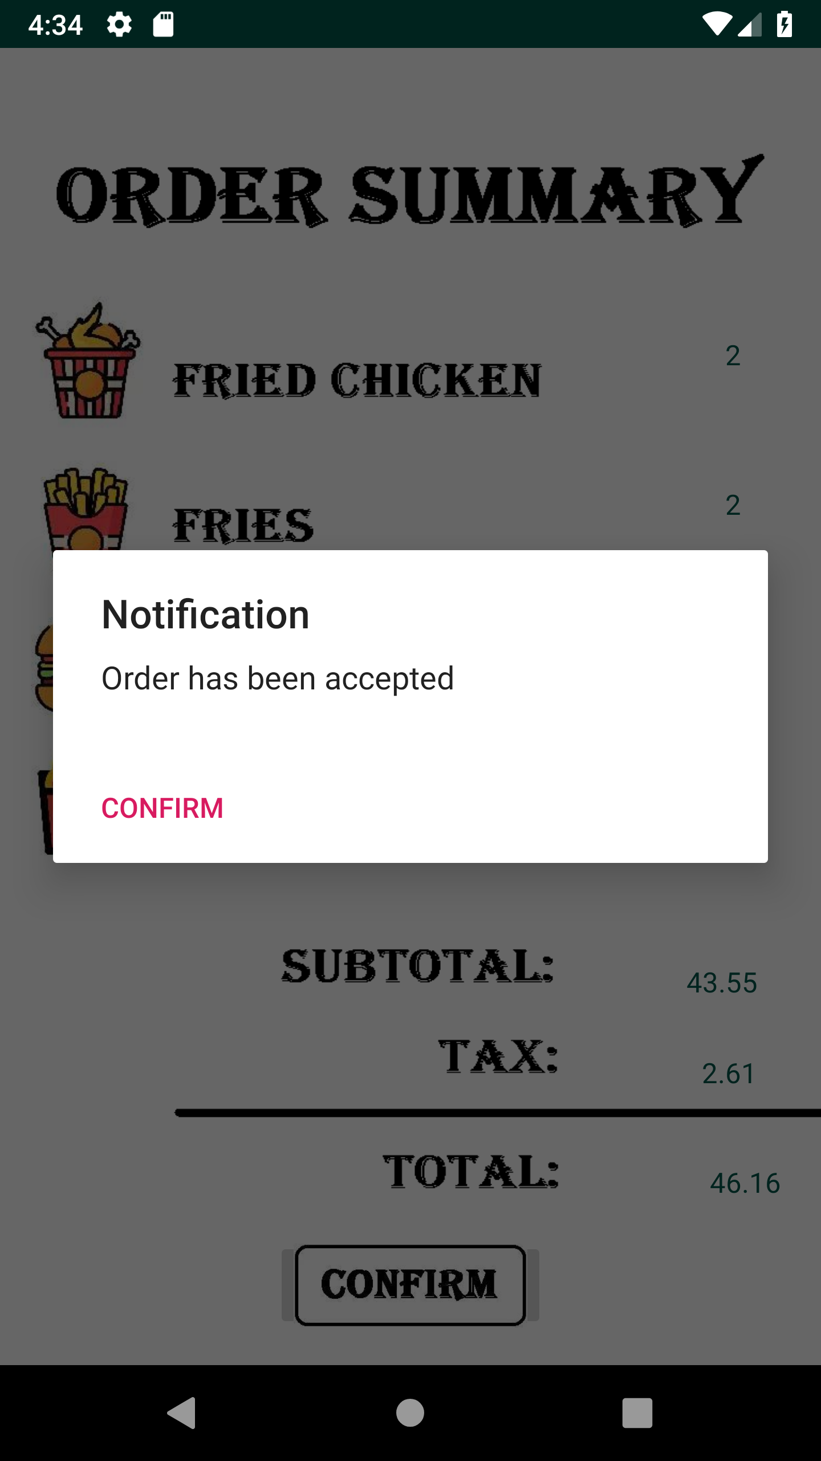
Cart Activity
Notification
When kitchen is confirmed with the order, a notification sent to the customer telling the results
Pressing “Confirm” will lead to the next screen
Similarly, use Bundle to store the final quantity for each item and pass to Finish Activity

Slide 24
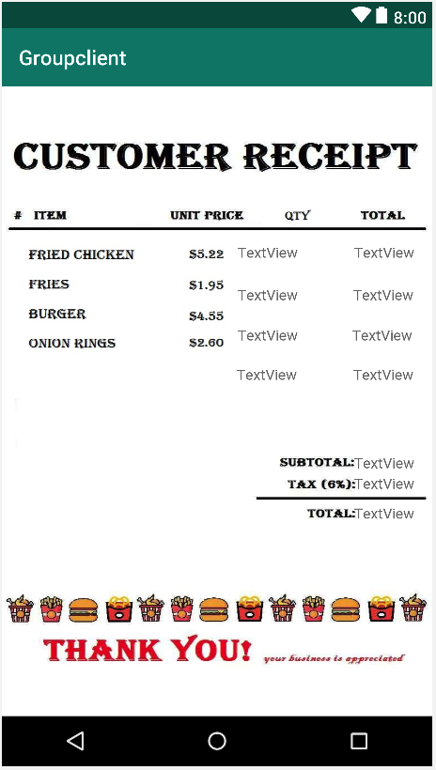
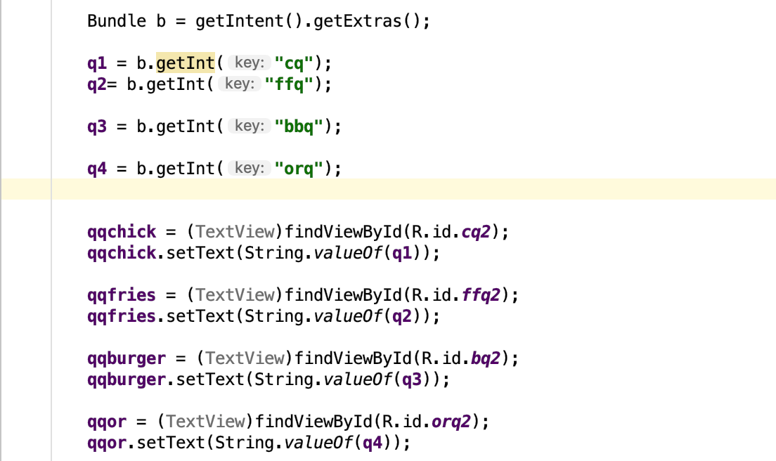
Finish Activity
UI Component
Text View – quantities:
Text View – Subtotal, Tax, Total Price

Slide 25
Customer: Back-end

Slide 26
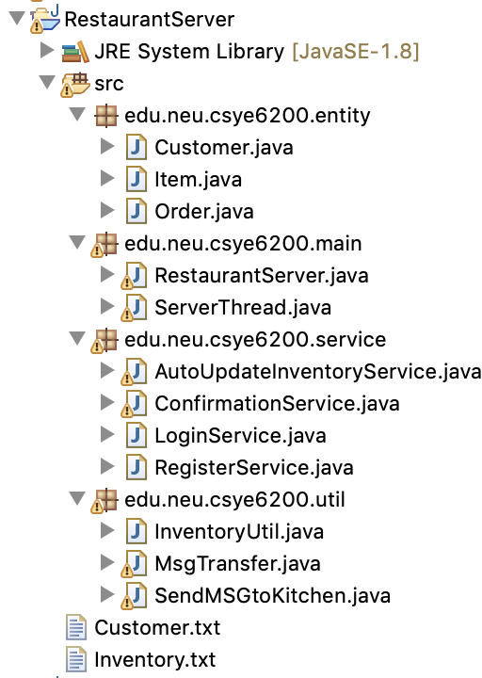
Server Structure
edu.neu.csye6200.entity
Customer: ArrayList<Order>
Order: Map<Item, Integer>
Item
edu.neu.csye6200.service
AutoUpdateInventoryService
ConfirmationService
LoginService
RegisterService
edu.neu.csye6200.util
InventoryUtil
MsgTransfer
SendMSGtoKitchen
edu.neu.csye6200.main
RestaurantServer
ServerThread
file
Inventory.txt
Customer.txt

Slide 27
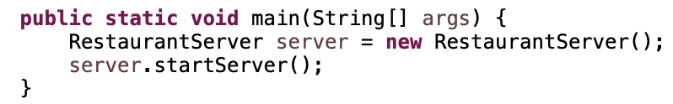
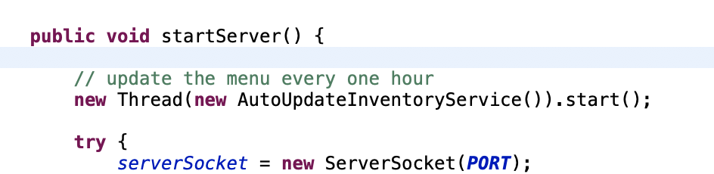
Server Running Logic
Multi-threading Multi-client

Slide 28
Server Business Logic
Receiver data from client
new ObjectInputStream(socket.getInputStream())
Deal with data
execute(MSG);
Send data to client
new ObjectOutputStream(socket.getOutputStream())
Socket socket: the Bridge
create connection
MsgTransfer MSG: the Car
Communication protoco
ServerThread

Slide 29
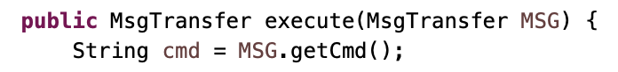
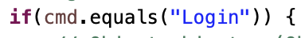
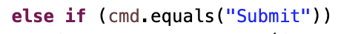

MsgTransfer Execute(MsgTransfer MSG)
Attribute: MsgTransfer MSG
String cmd
Object data
String IP
boolean flag;
String result
implements Serializable
the package name must be same.

Slide 30
Main Function
Manage Inventory
public static ArrayList<Item> readInventoryFromFile()
public static synchronized void writeInventoryToFile(ArrayList<Item> inventoryList)
public static synchronized void updateInventoryByOrder(Order order)
public static synchronized void autoUpdateIventory()
Synchronize!
Modify the inventory.txt file

Slide 31
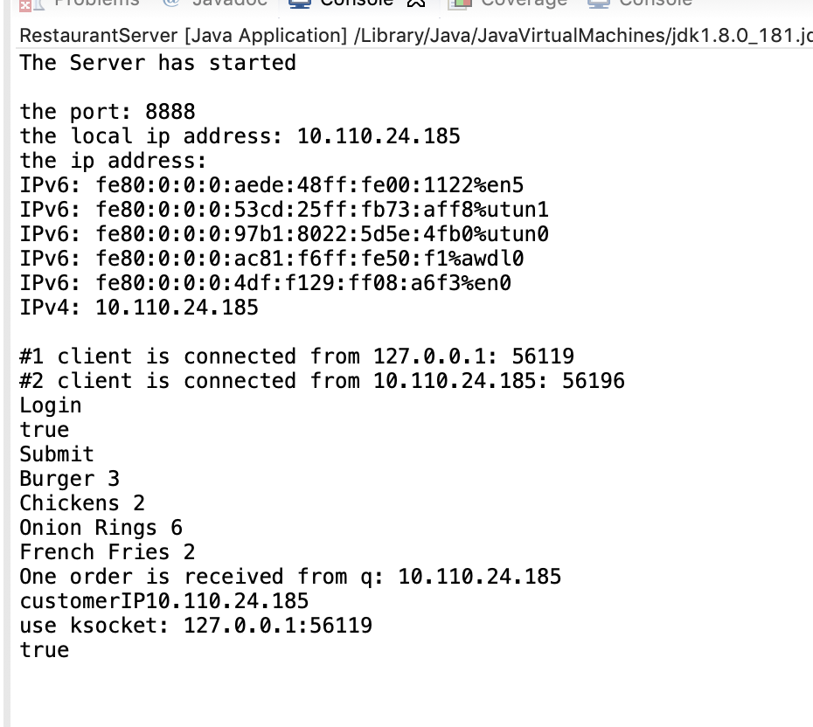
Console Logcat

Slide 32
Kitchen: Front-end

Slide 33
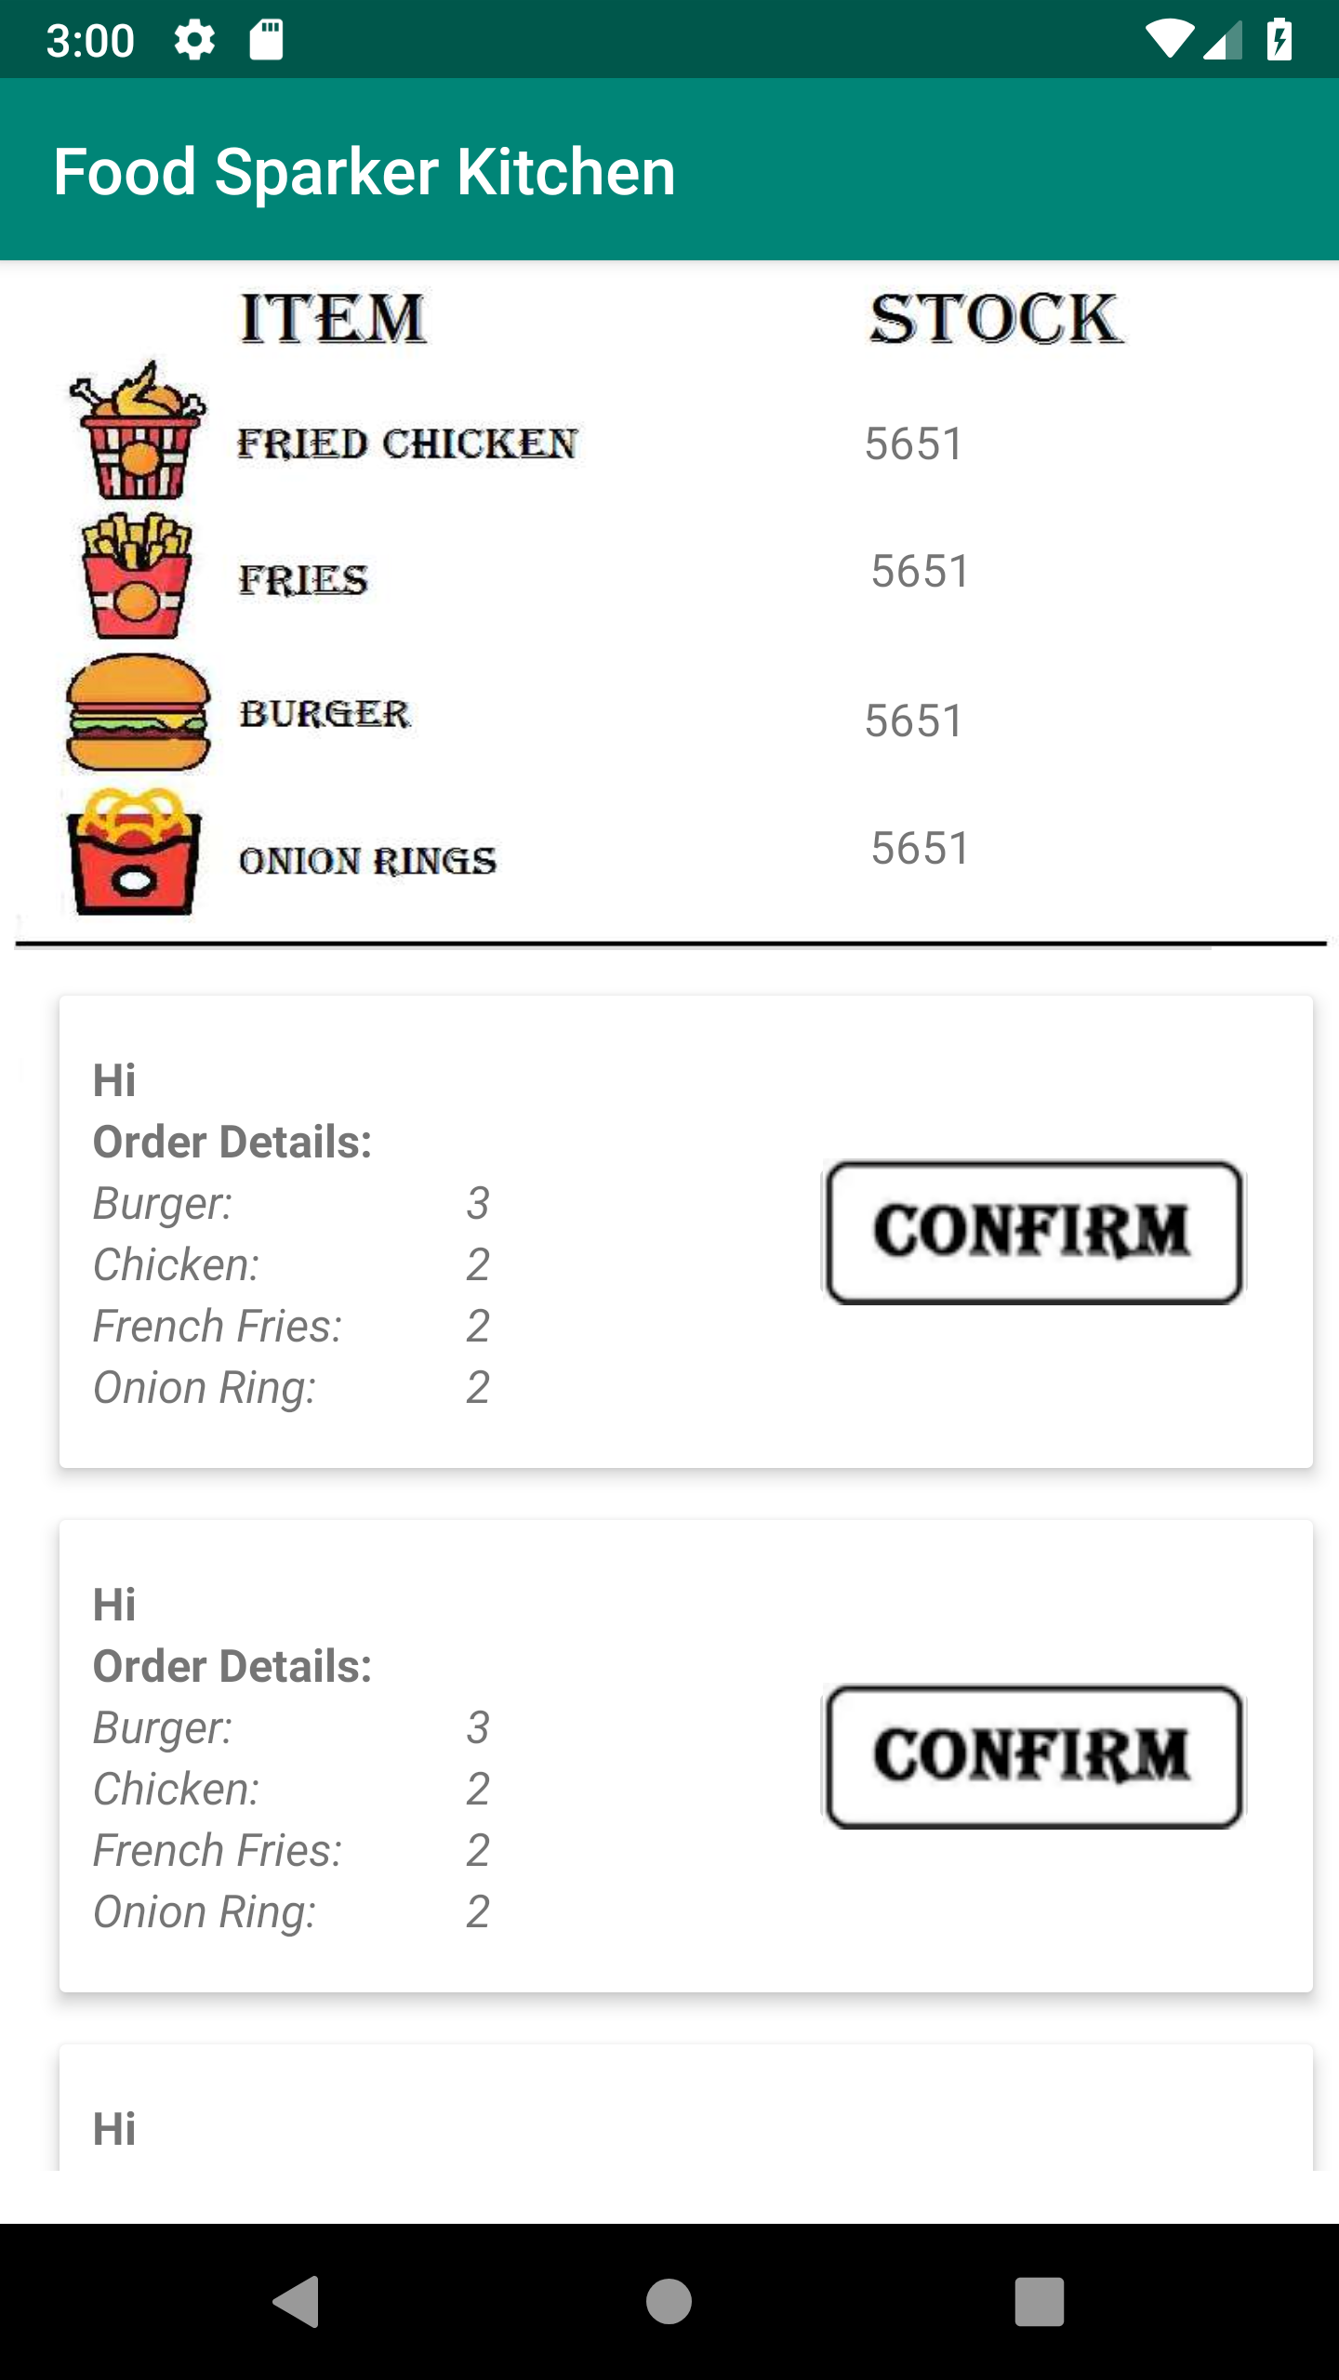
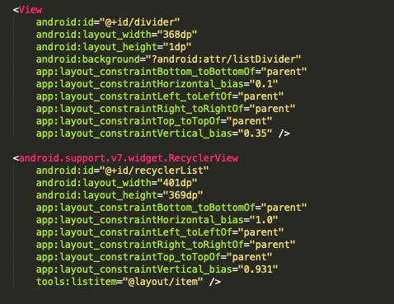
Kitchen Layout
TextView
View
RecyclerView

Slide 34
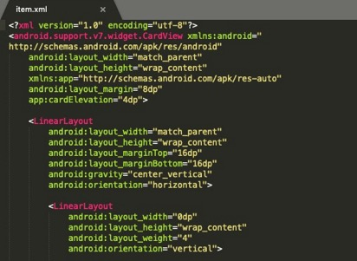
Item Layout
TextView
ImageButton

Slide 35
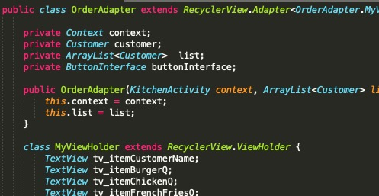
Adapter
onCreateViewHolder（）:
Responsible for holding all the layout of each component.
onBindViewHolder（）:
Responsible for binding data to each component holder.

Slide 36
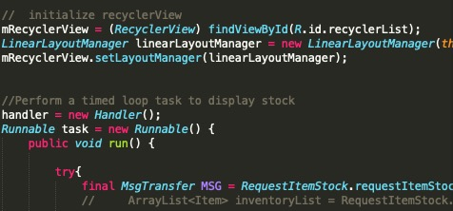
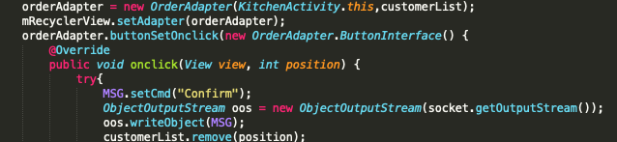
Kitchen Activity
Connect the adapter and set button:

Slide 37
Kitchen: Back-end

Slide 38
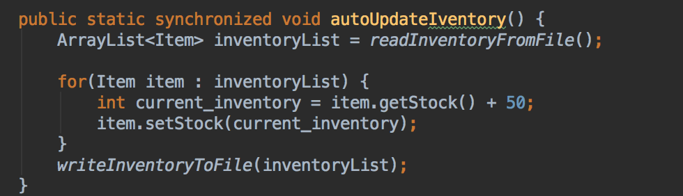
Auto-update Inventory
autoUpdateInventory(){}:
Add 50 to inventory for each item. (Adjustable Time)

Slide 39
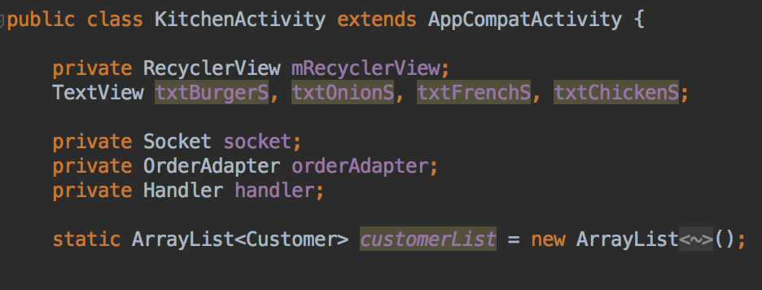
Kitchen Activity
Socket
Connect to server

Slide 40
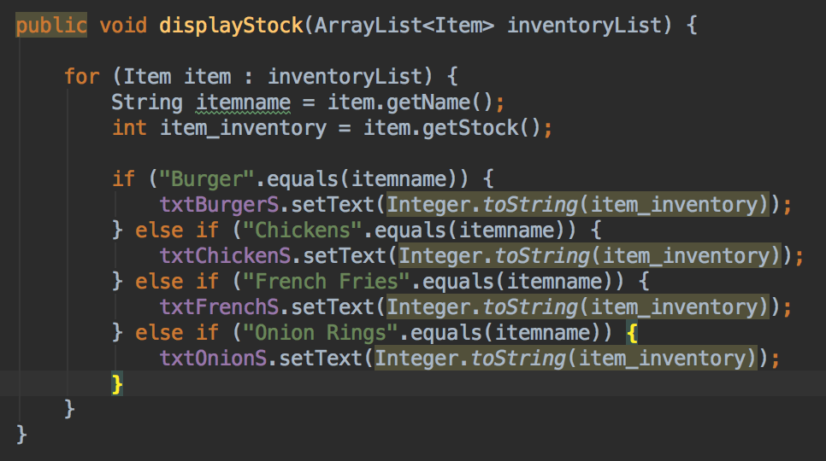
Display Inventory
displayStock(){}

Slide 41
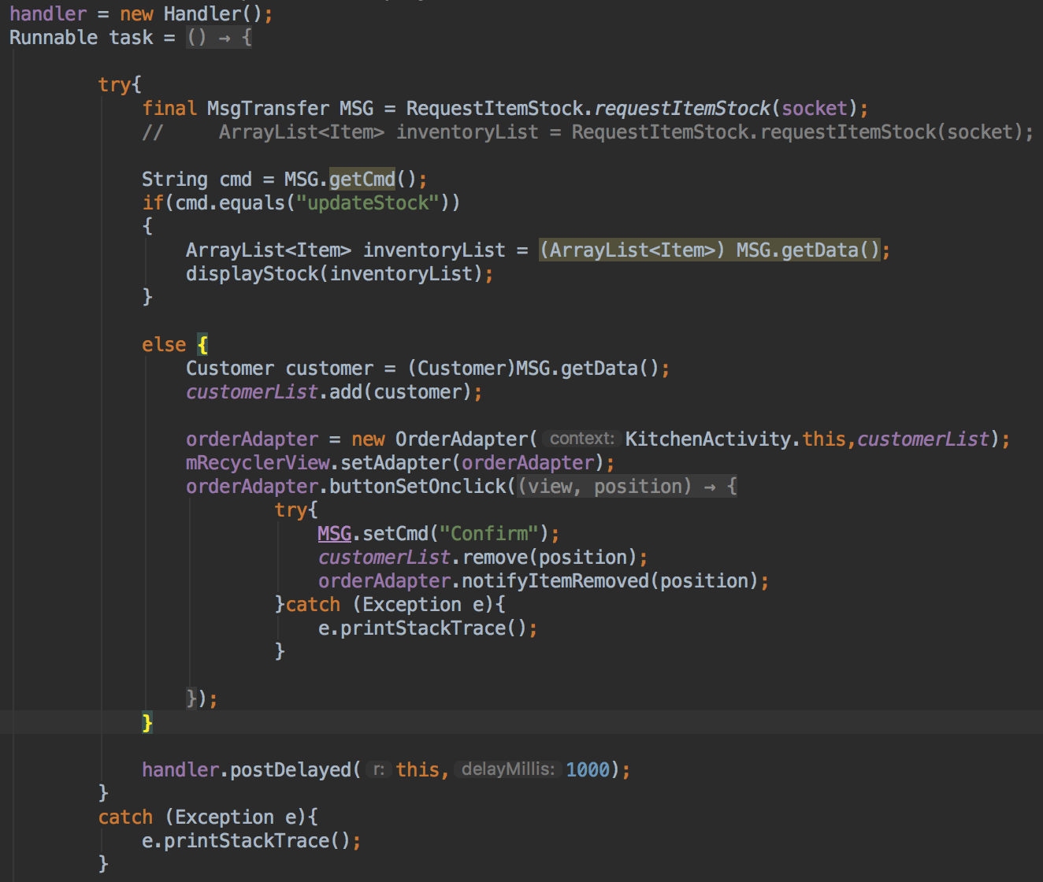
Handler
Send request to get newest inventory and display

Slide 42
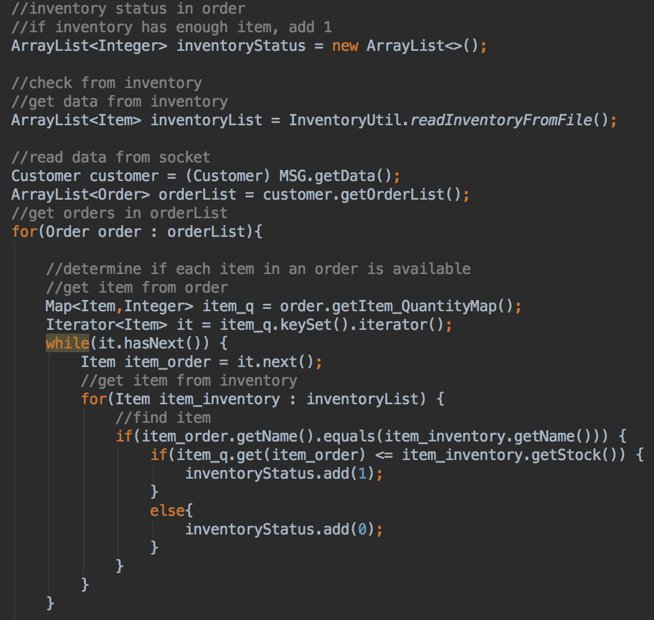
Check with inventory

Slide 43
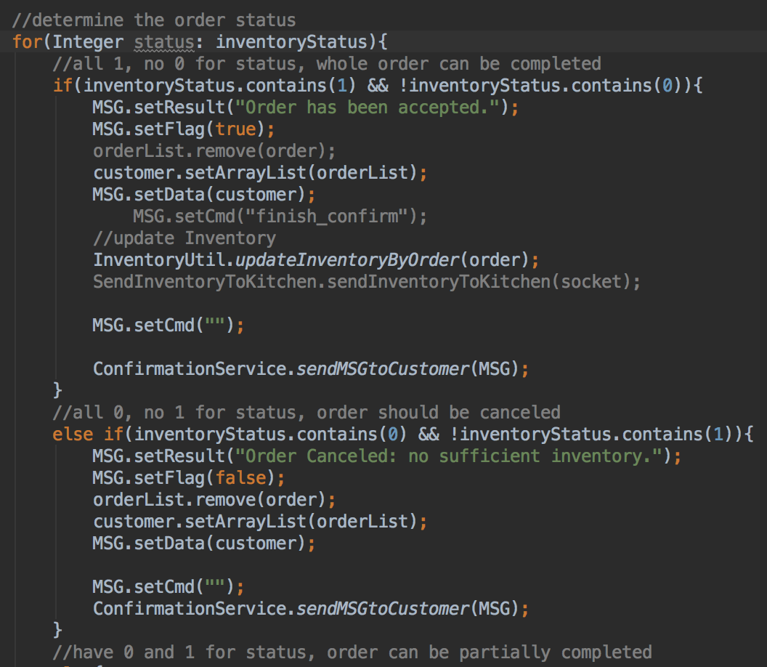
order status

Slide 44
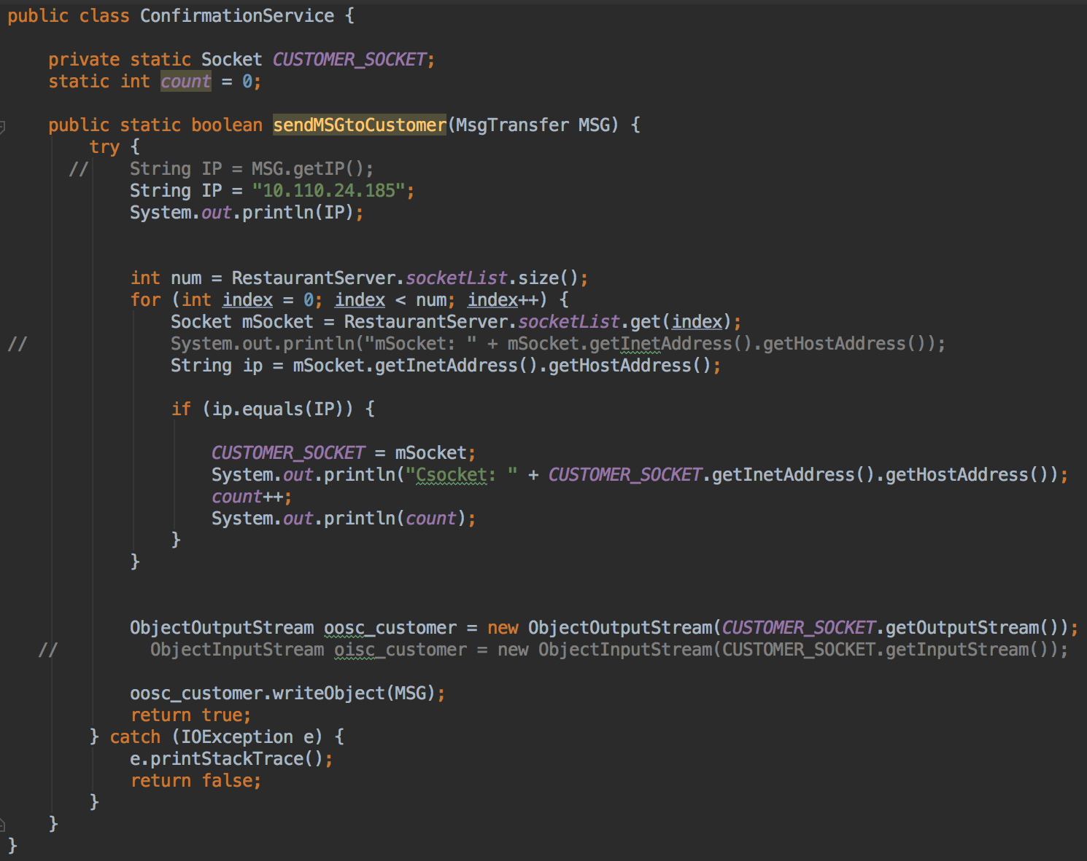
Confirmation

